Slide 1
LAB 1
Made for Professor Lanham A. by Amrit Singh

Slide 2
AGENDA
Accessing the AWS management console
Task 1 : Create your VPC
Task 2 : create additional subnets
Task 3 : Creating a VPC security group
Task 4: Launch a Web Server Instance

Slide 3
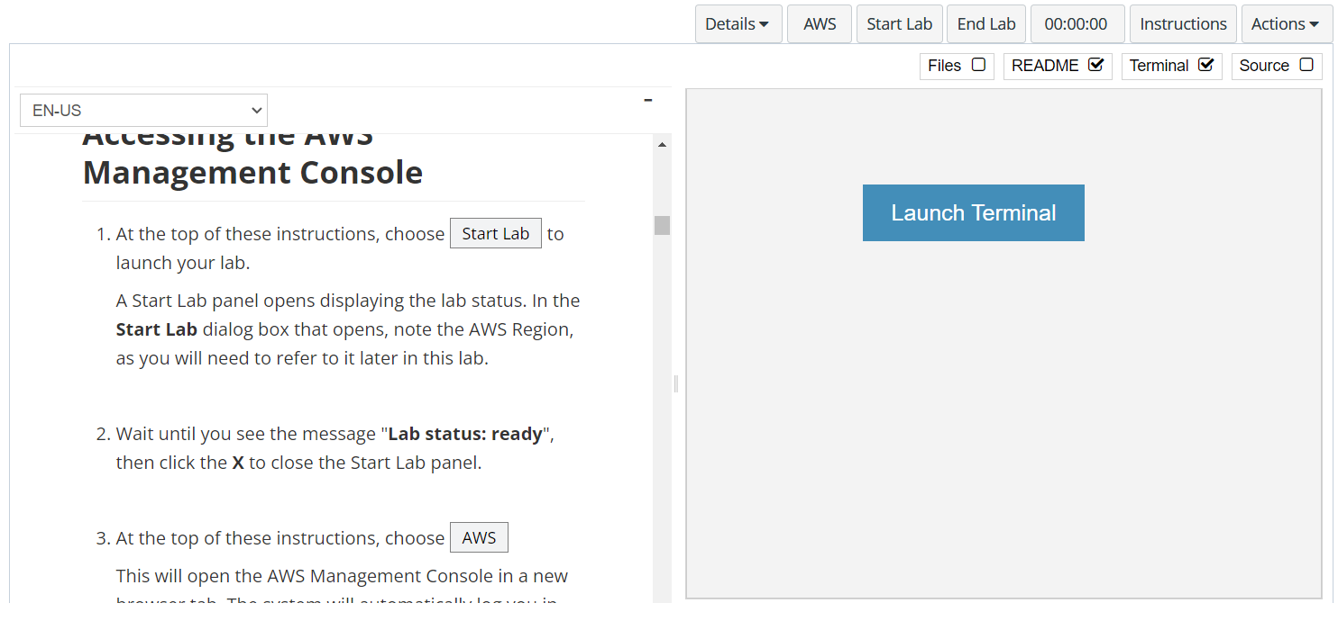
In aws labs click on start lab

Slide 4
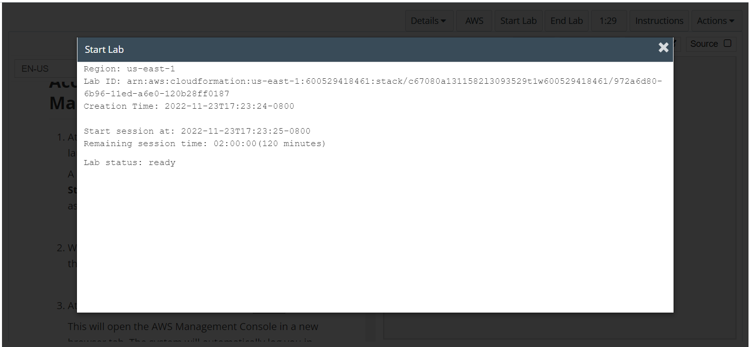
Wait to see lab ready status in the window then press x and click on aws to launch console

Slide 5
Task 1 : Create your vpc

Slide 6
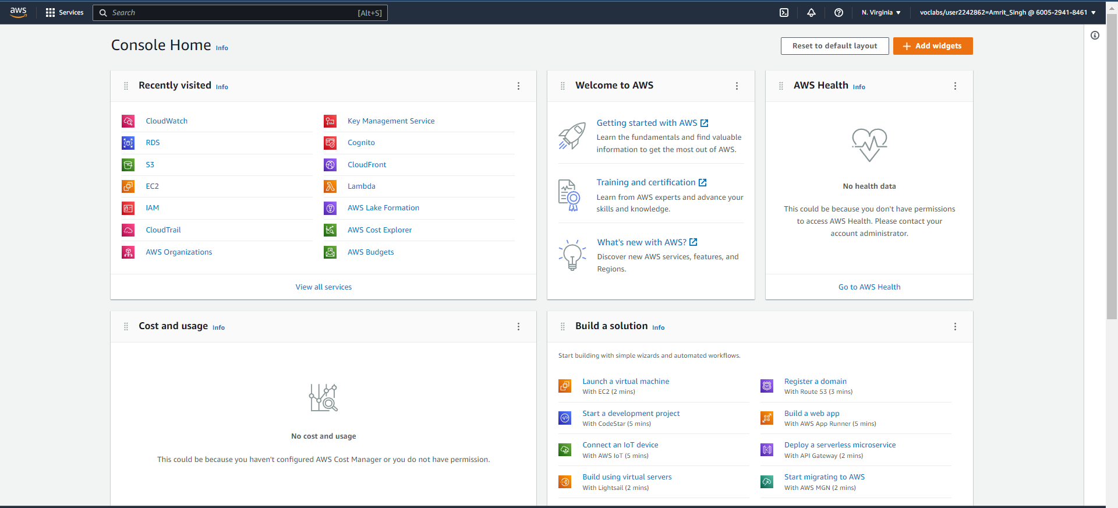
Homepage of the console

Slide 7
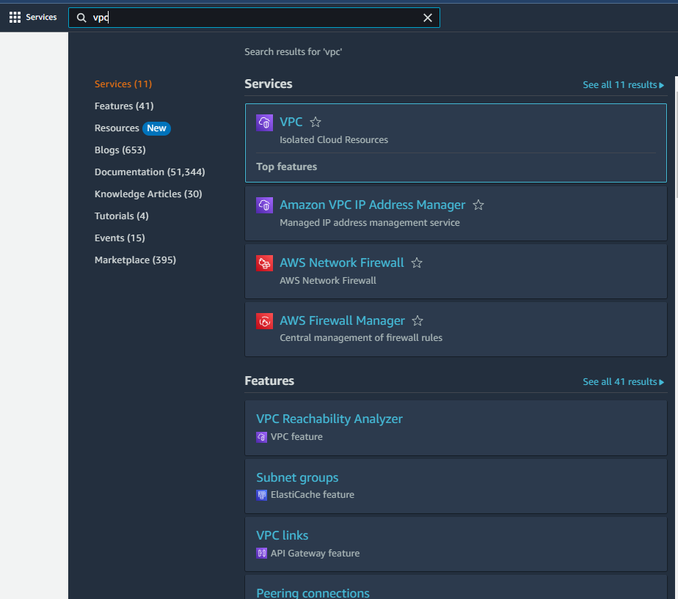
LICK ON SEARCH NEXT TO SERVICES AND TYPE VPC
Click on the VPC button

Slide 8
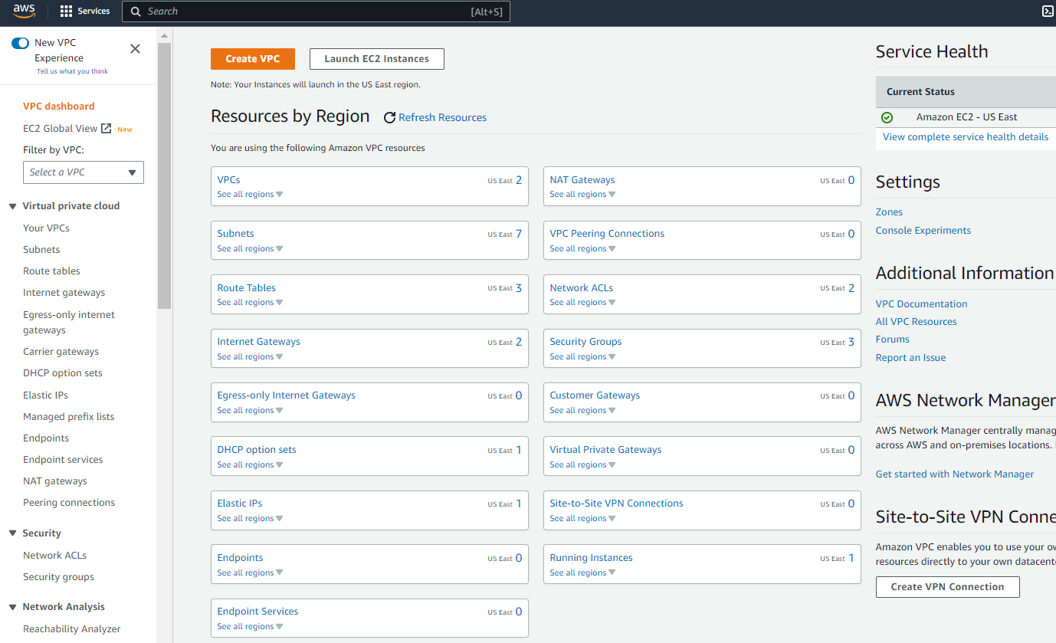
VPC DASHBOARD
Click on the create VPC

Slide 9
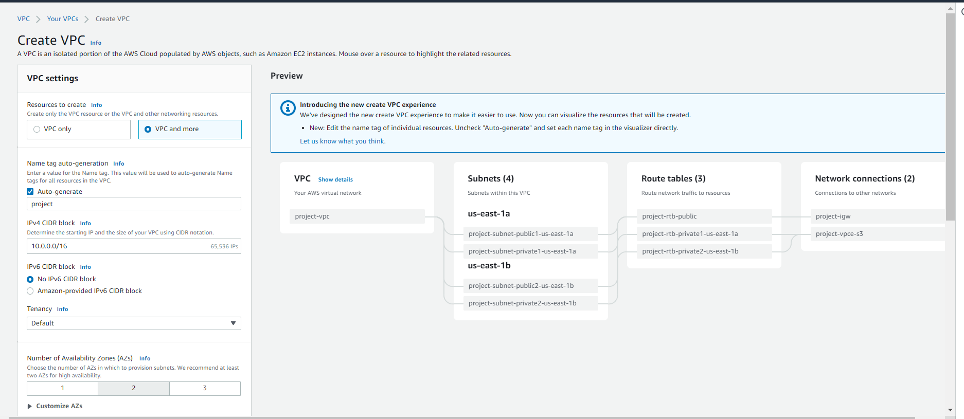
CONFIGURE THE VPC SETTINGS AS MENTIONED

Slide 10
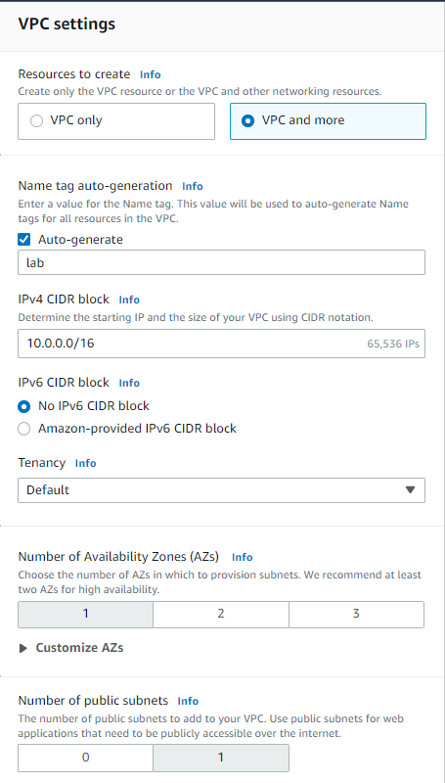
CONFIGURE THE VPC SETTINGS AS MENTIONED

Slide 11
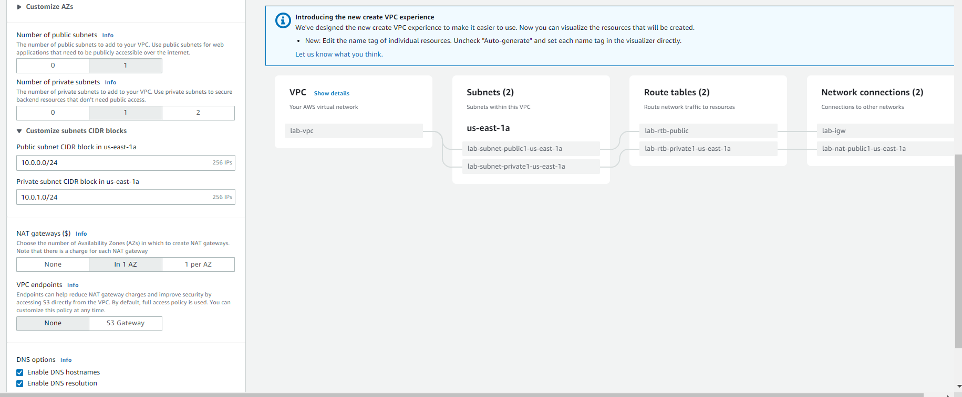
CONFIGURE THE VPC SETTINGS AS MENTIONED

Slide 12
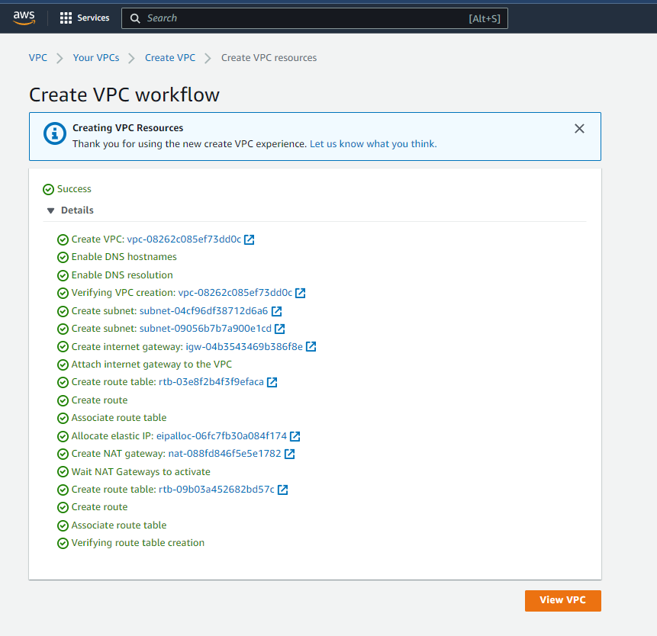
CLICK ON CREATE VPC TO CREATE VPC WORKFLOW AND THEN CLICK VIEW VPC

Slide 13
Task 2 : CREATE ADDITIONAL SUBNETS

Slide 14
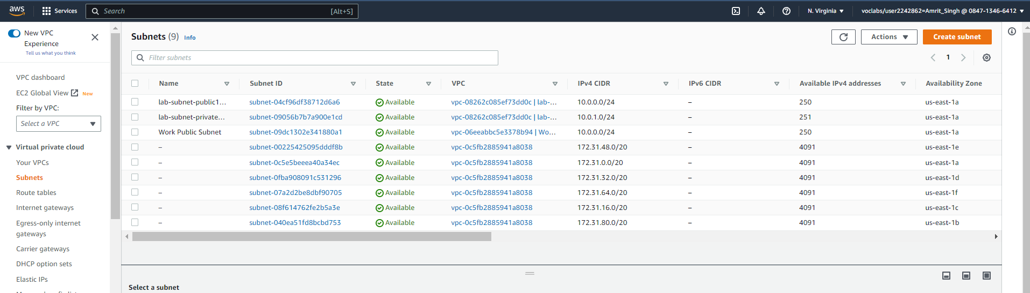
CLICK ON SUBNETS TO GO TO THE SUBNET PAGE AND THEN CLICK CREATE SUBNET

Slide 15
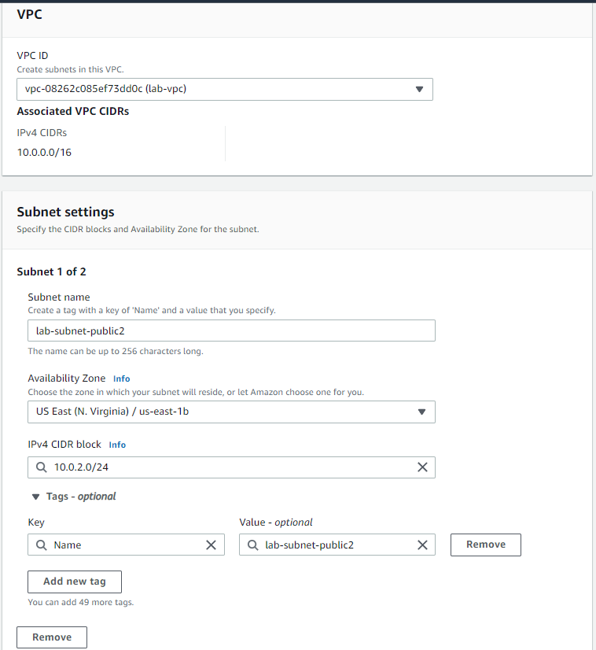
Configure the first subnet settings as shown

Slide 16
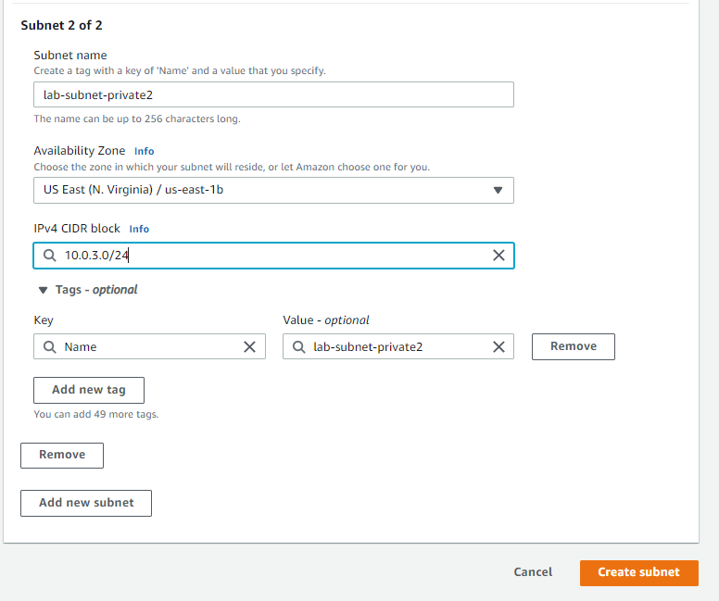
Configure the second subnet settings as shown and then click create subnet

Slide 17
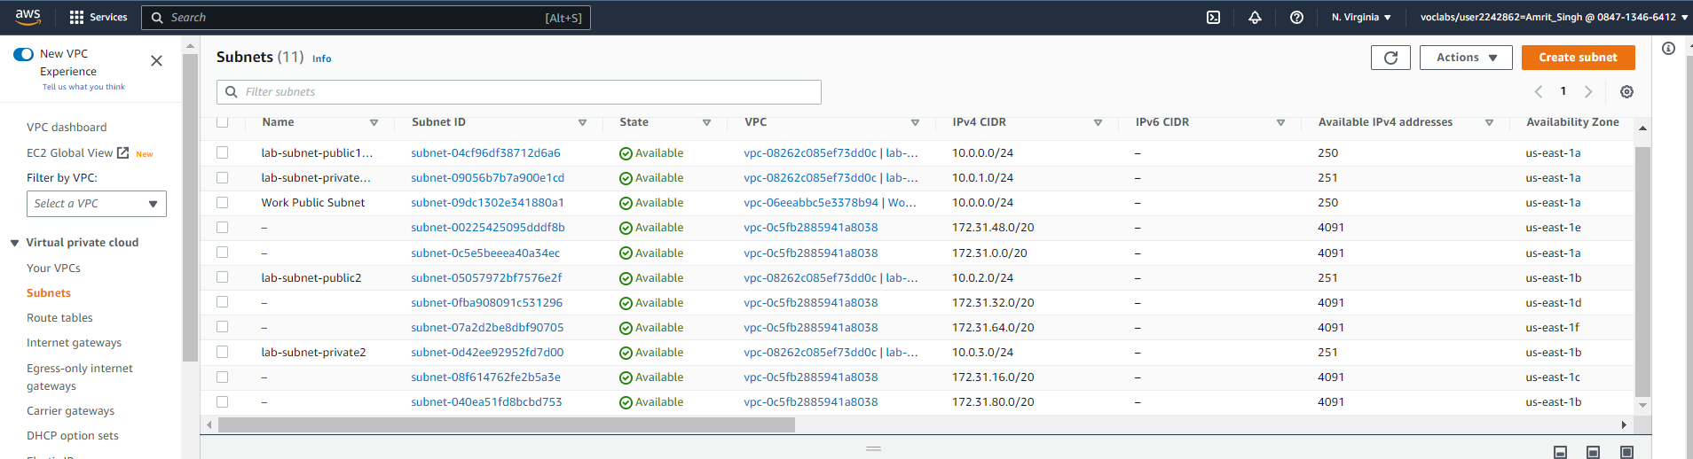
2 subnets will be generated in the subnet pane, next choose route tables to edit the route table
Click on Route Table

Slide 18
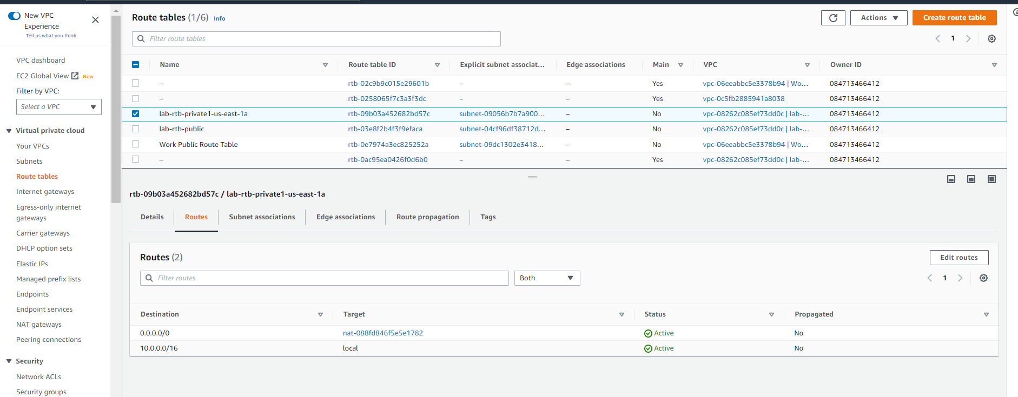
ROUTE TABLES DASHBOARD SHOWING THE DETAILS OF THE ROUTES CONFIGURED
Select lab-rtb-private1-us-east-1a route table

Slide 19
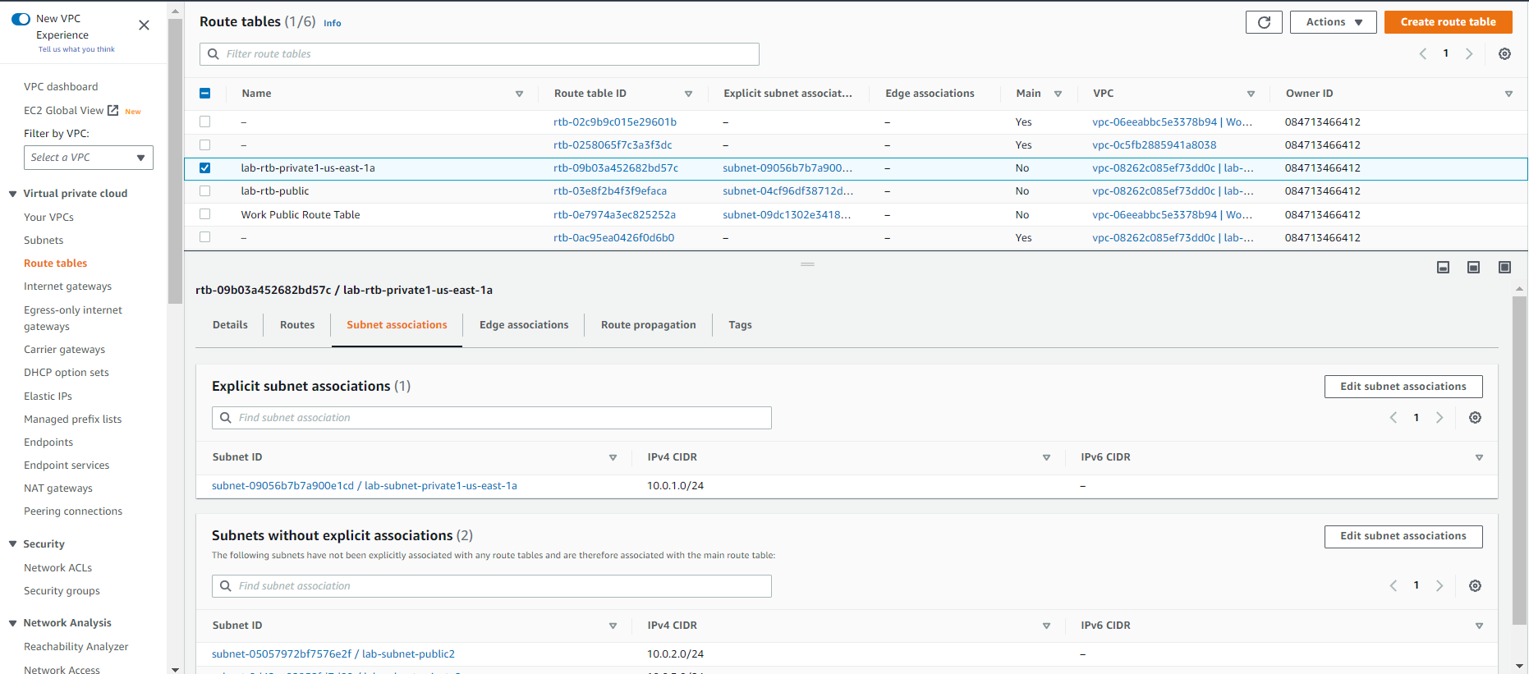
CLICK ON SUBNET ASSOCIATIONS TAB AND THEN CLICK EDDIT SUBNET ASSOCIATIONS TO EDIT THE ASSOCIATIONS
Click on subnet associations
Click on edit subnet associations

Slide 20
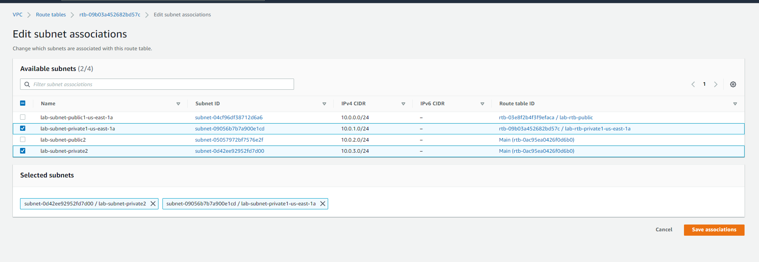
Select lab-subnet-private2 along with lab-subnet-private1-us-east-1a in the edit subnet associations dashboard and then press save association

Slide 21
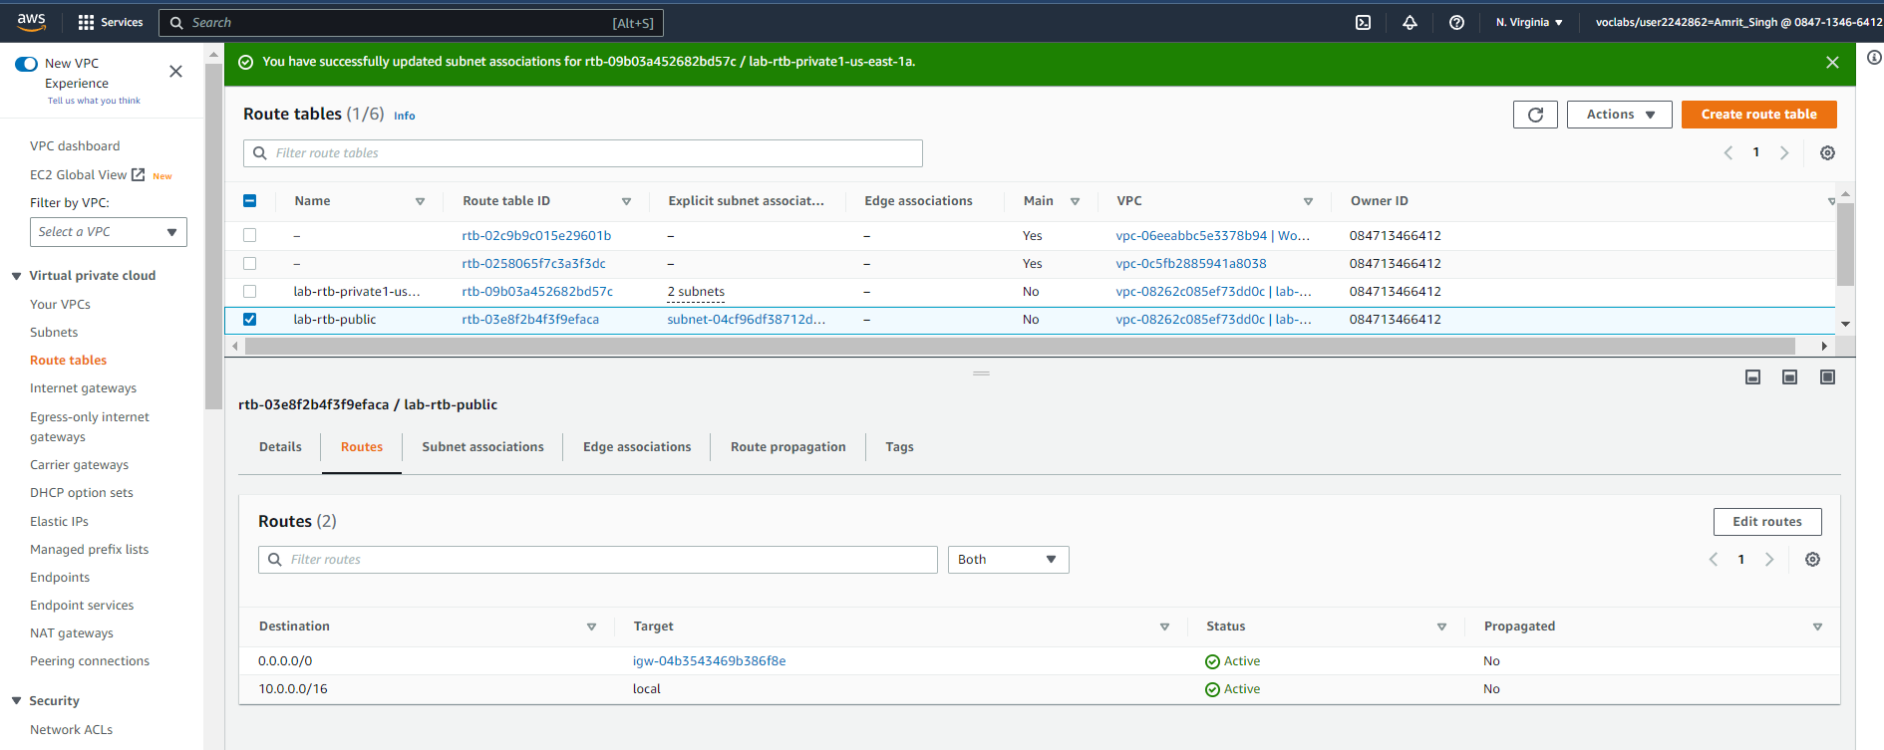
Select lab-rtb-public route table

Slide 22
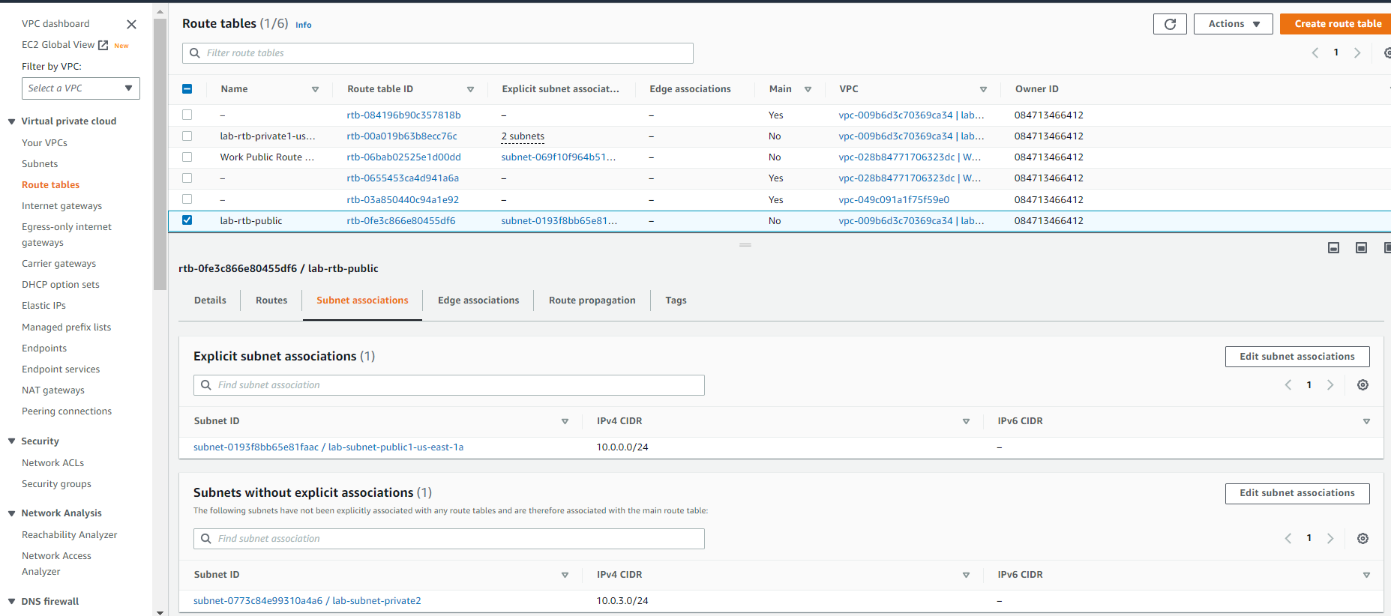
Choose subnet association and then click edit subnet association

Slide 23
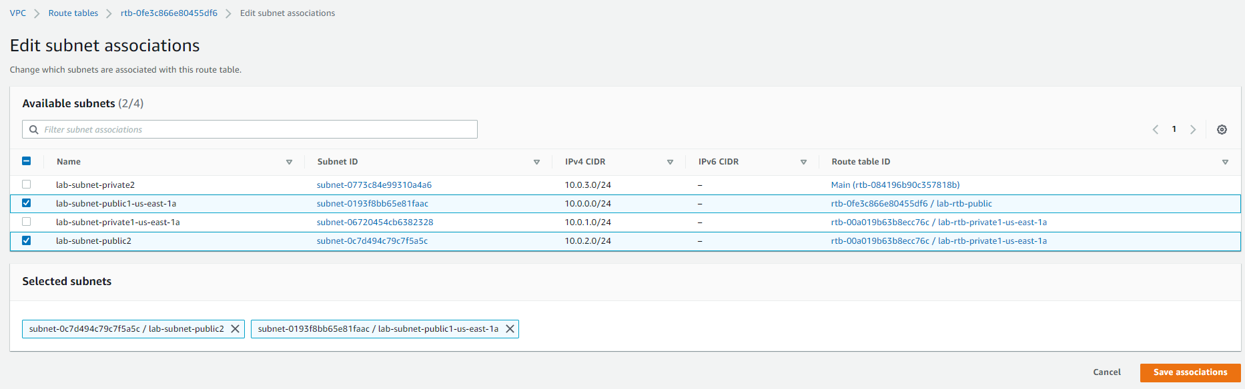
Choose lab-subnet-public2 along with lab-subnet-public1-us-east-1a and click save association

Slide 24
Task 3 : Creating a vpc security group

Slide 25
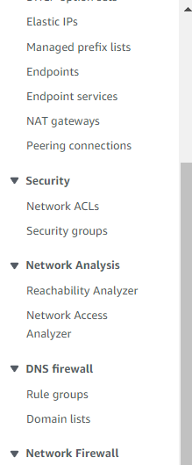
In navigation pane choose security groups
Choose security groups

Slide 26
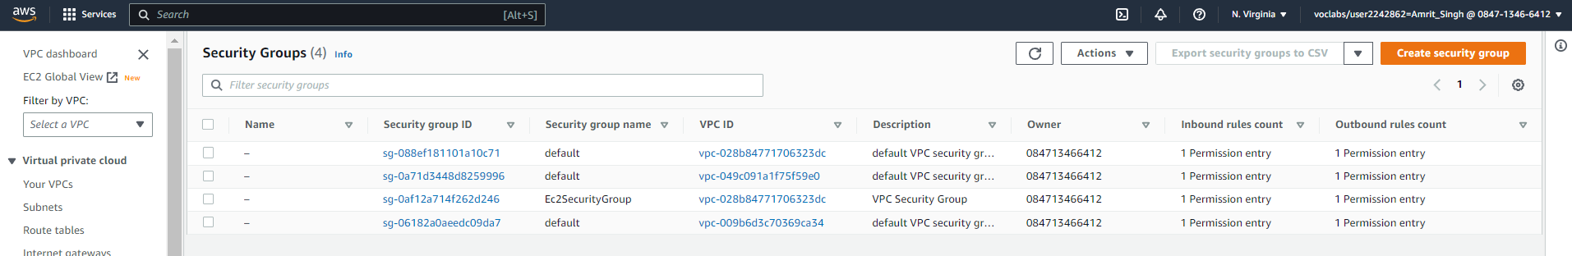
Security group dashboard, click on create security group

Slide 27
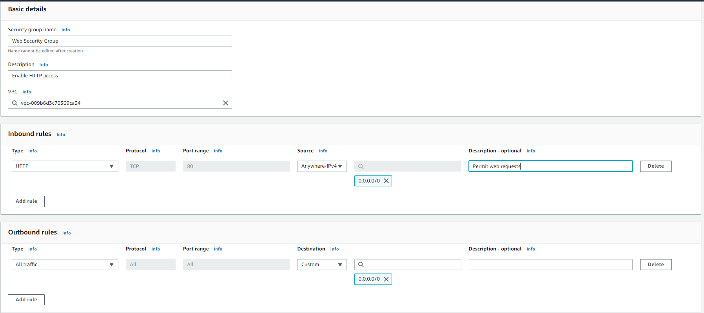
Update the security group configuration as shown and click create security group at the end of the page

Slide 28
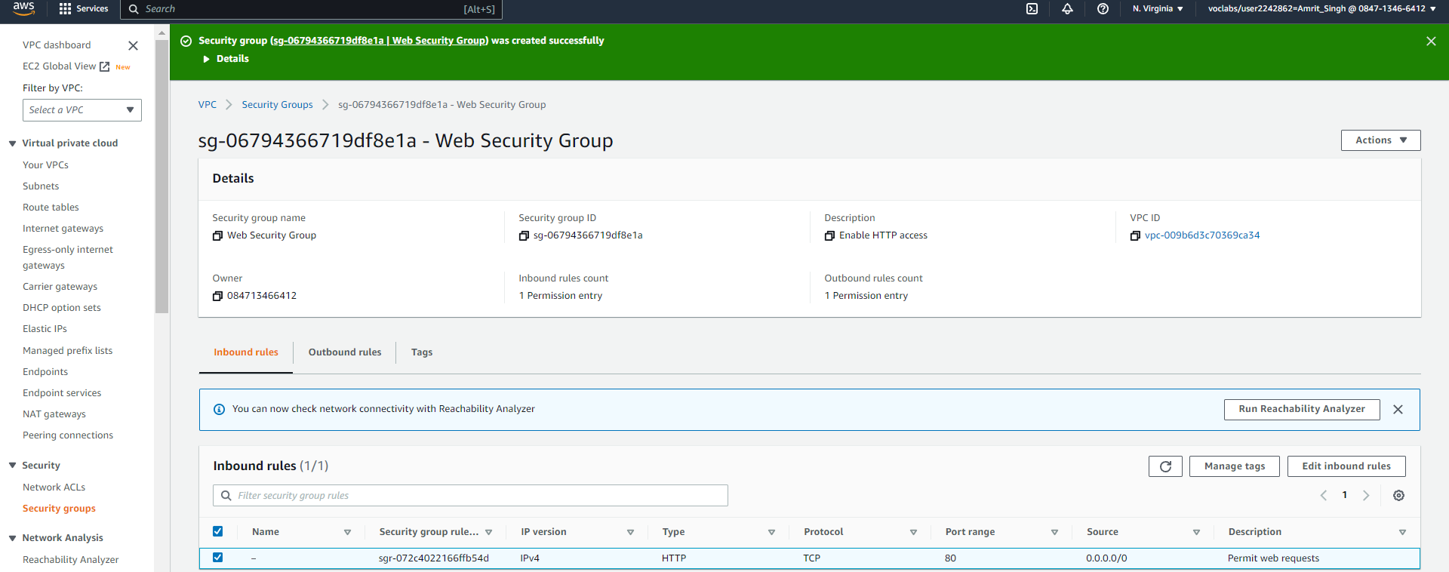
SECURITY GROUP CONFIGURED

Slide 29
Task 4 : LAUNCH A WEB SERVER INSTANCE

Slide 30
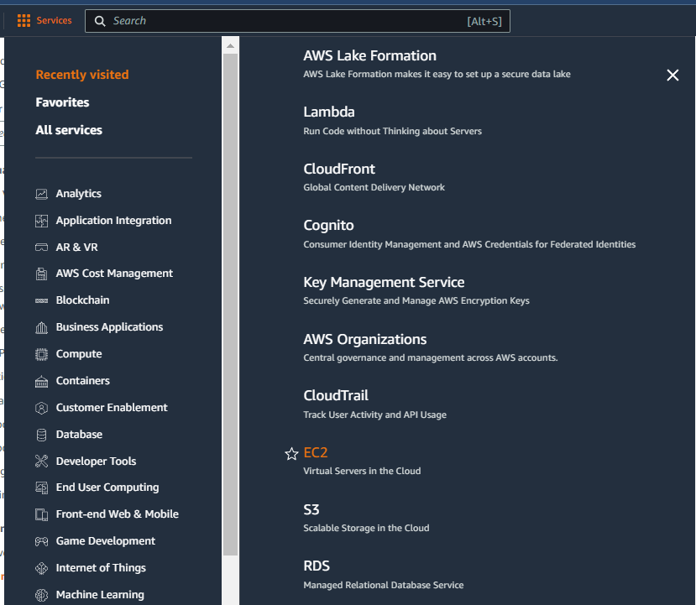
SELECT EC2 IN SERVICES MENU

Slide 31
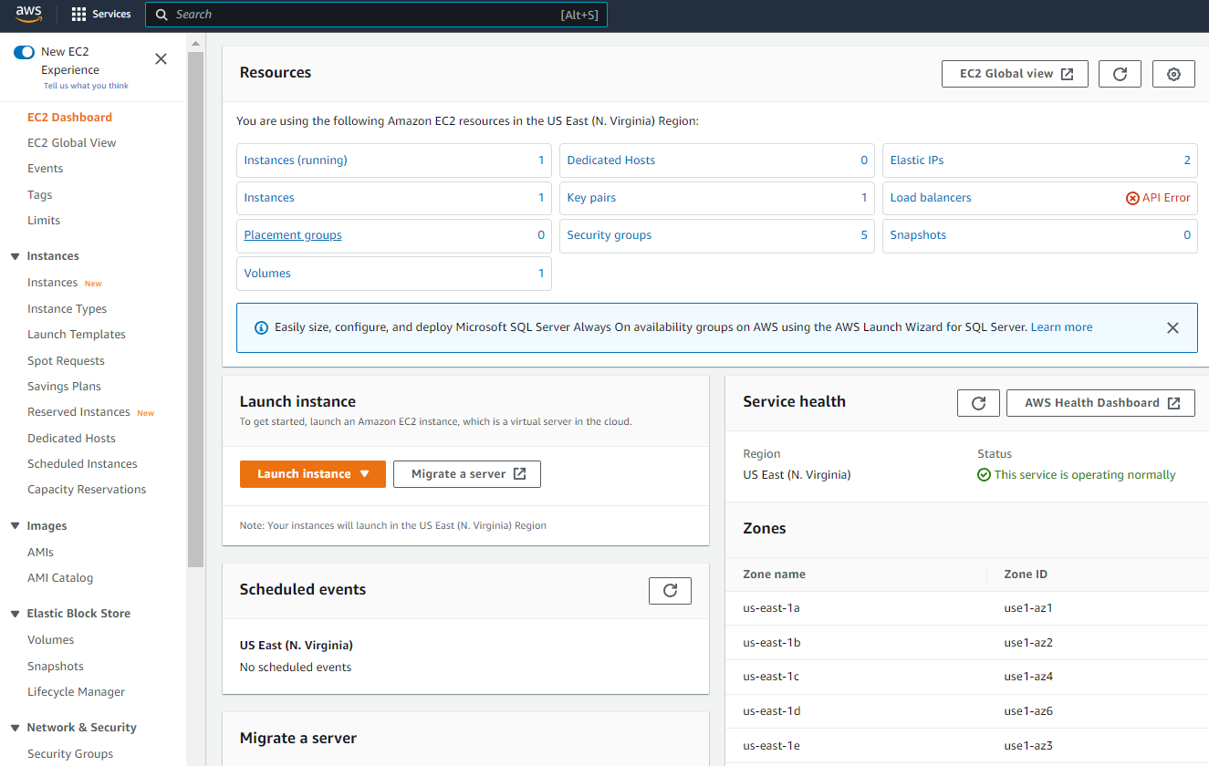
Click on launch instance in ec2 dashboard
Click on launch instance

Slide 32
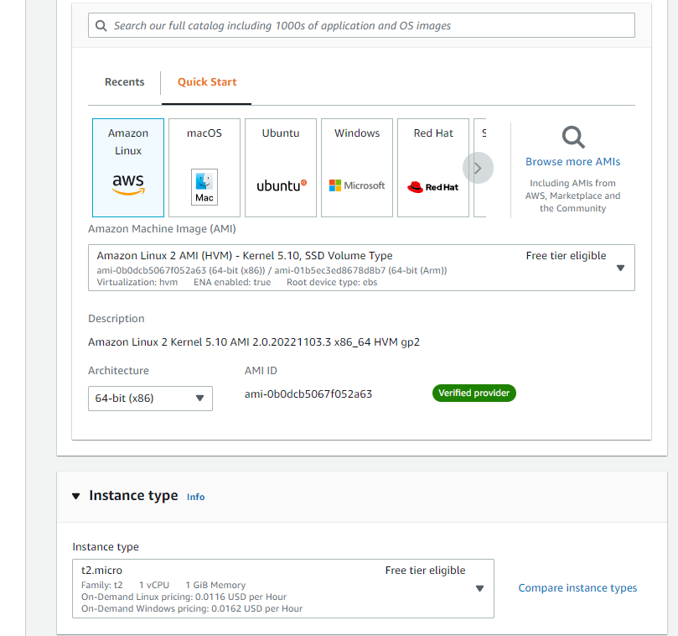
In the quick start menu choose amazon linux as the ami and update the settings based as per aws labs

Slide 33
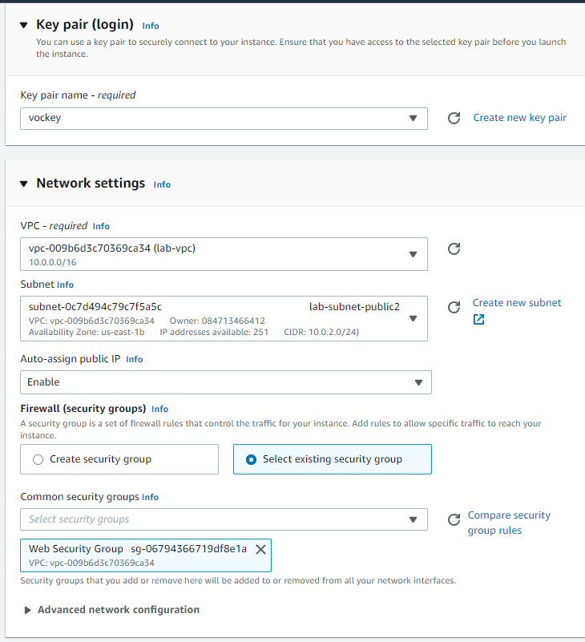
Choose key pair as vockey and update the network settings based on aws labs

Slide 34
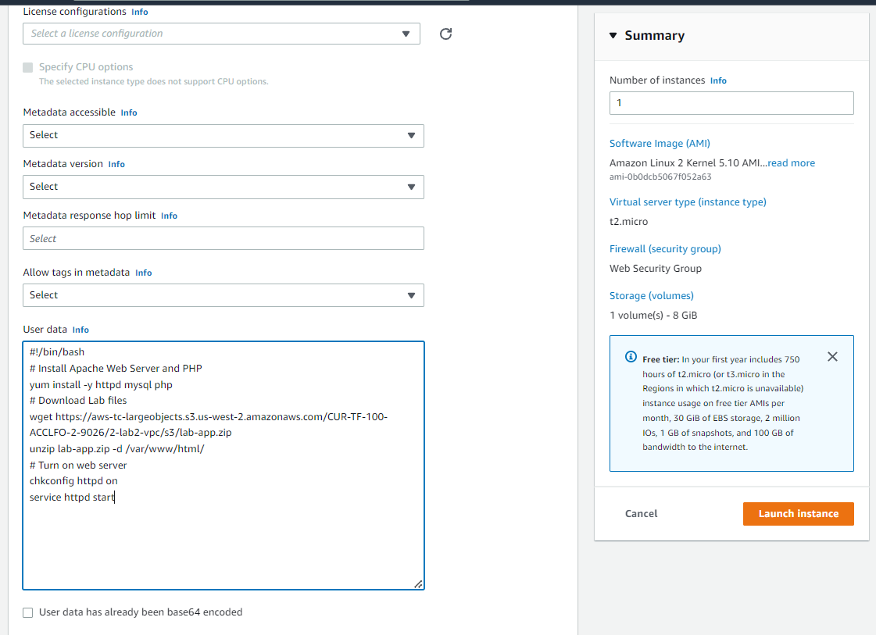
Add user data towards the bottom in advanced ec2 settings and hit launch instance

Slide 35
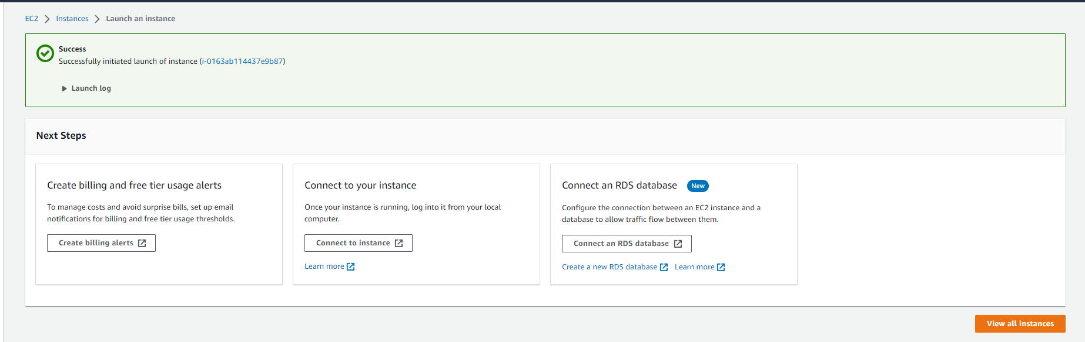
Ec2 instance created successfully, choose view all instances

Slide 36
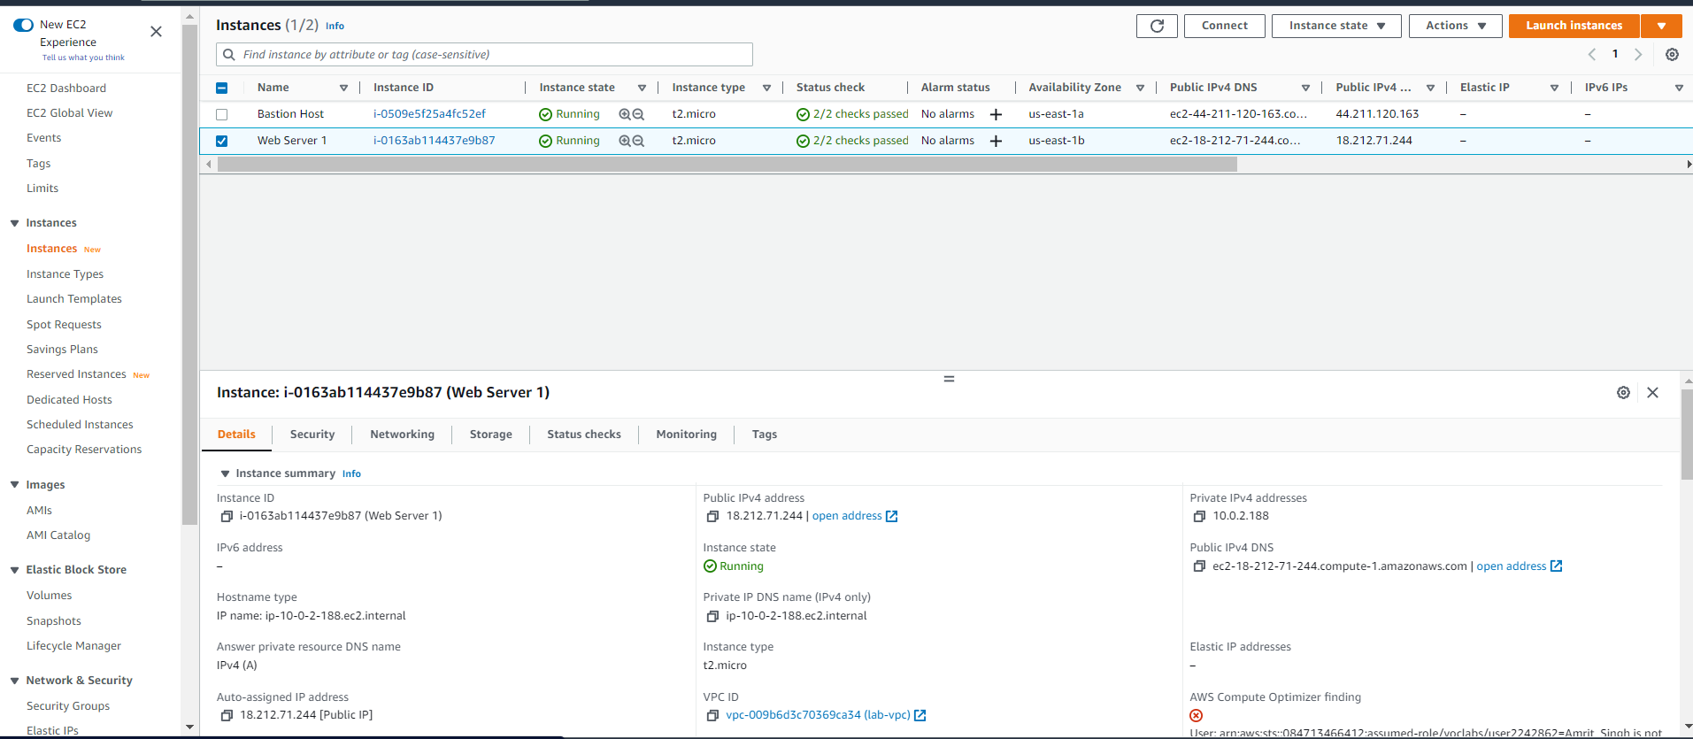
Wait for web server 1 to show up on the instance dashboard and for checks to pass, copy the public ipv4 address from the details tab and paste it in the browser
Copy IPV4 address

Slide 37
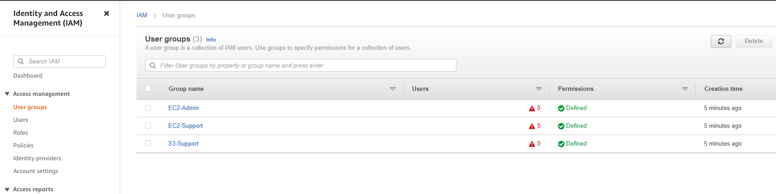
Click on EC2 – admin and then choose users tab
Click on EC2-admin groups

Slide 38
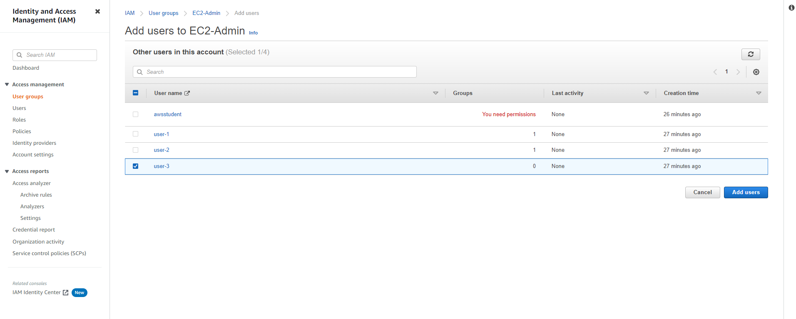
Click on add users in ec2-admin
Click on add users groups

Slide 39
THANK YOU
Amrit Singh

